Slide 1


HEALTH CARE management system
DEPARTMENT OF INFORMATION TECHNOLOGY
VR SIDDHARTHA ENGINEERING COLLEGE
(AVANTEL)
PRESENTED BY:
208W1A1237 - LAKSHMI THANUJA DEVATHU
208W1A1263 - JAHNAVI VELISALA
UNDER THE GUIDANCE OF:
Y.KALYAN CHAKRAVARTHI, ASSISTANT PROFESSOR

Slide 2
contents
Problem Statements
Objectives and Outcomes
Literature Review
Architecture Diagram
Flow diagram
Data flow diagram with Implementation steps.

Slide 3
Problem Statement
To develop a web application and mobile application to provide health care services for doctors, patients and pharmacists.

Slide 4
Objectives And Outcomes
OBJECTIVE:
To develop both web and mobile applications that contains features aiming the requirements of doctors, patients, lab operators and pharmacists with authentication and security.
OUTCOME:
Web Application and Mobile App for both operating systems (Ios & Android ) where users can consult a doctor via text ( or ) voice ( or ) video by scheduling an appointment before hand.
Patients are able to easily book lab tests and medicines prescribed by doctor.
It has e-prescription of doctor which will be easy for pharmacists.

Slide 5
Literature Review
These applications provides health care services
PRACTO APP:
24/7 doctor consultations
Booking appointments and lab tests
Digital prescription
FAMILY DOCTOR APP:
Book appointments
Add them to your calendar
Get reminders
Online check-in and queue information
Important health updates

Slide 6
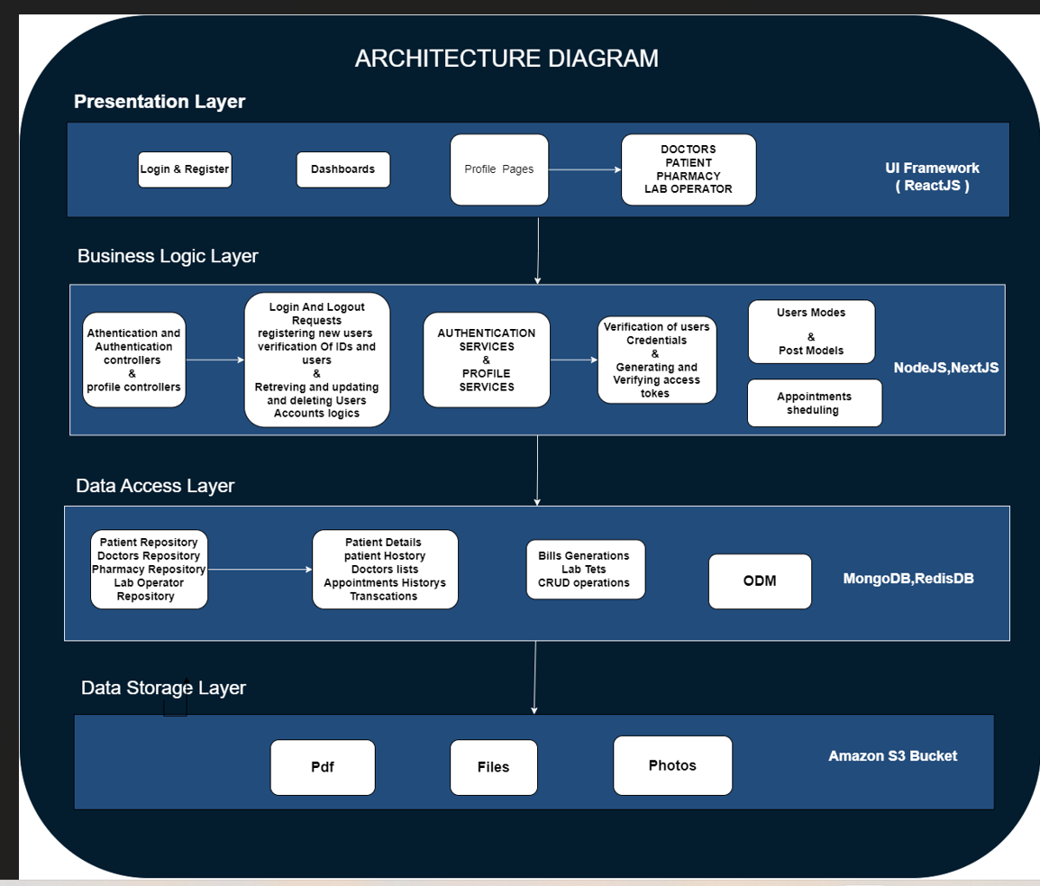
ARCHITECTURE DIAGRAM

Slide 7
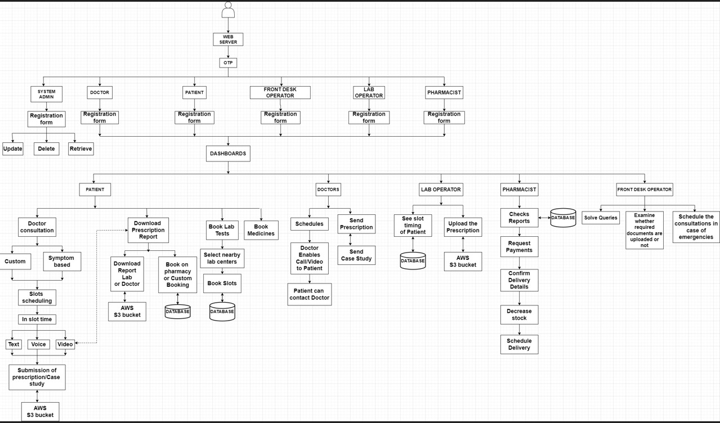
FLOW DIAGRAM

Slide 8
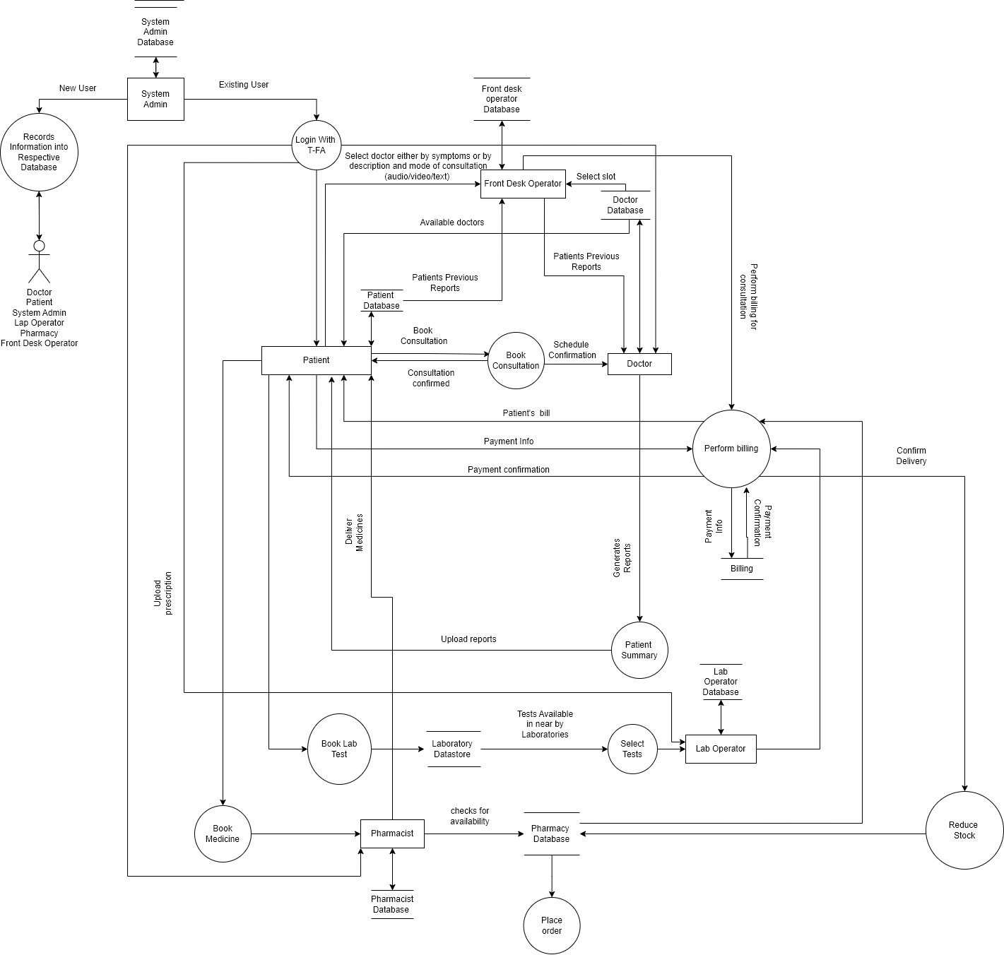
DATA FLOW DIAGRAM

Slide 9
Data flow diagram implementation steps
The actor (Patient, Doctor, Lab Operator, Pharmacist, Admin, Front Desk Operator) logs in with their phone number and OTP authentication.
Once logged in, the actor registers with their respective fields of details.
After registration, the Patient is presented with a list of Doctors from which they can choose for treatment.
The Patient provides details of their symptoms to the chosen Doctor.
If online service is chosen, the Doctor and Patient communicate through a video or audio call for the treatment.
The Doctor suggests lab tests if needed, and the Patient completes the tests and submits the report to the Doctor.
After reviewing the report, the Doctor prescribes medication to the Patient.
The Patient can choose to buy the prescribed medication or opt for door delivery.
If the Patient decides to buy the medicine, they make the transaction with the respective Pharmacist.
The Pharmacist provides the medication to the Patient.
If the Patient chooses door delivery, the Pharmacist delivers the medication to the Patient.

Slide 10
THANK YOU

